Slide 1
Amazon Sales Data Analysis in SQL
-Arjun Menon

Slide 2
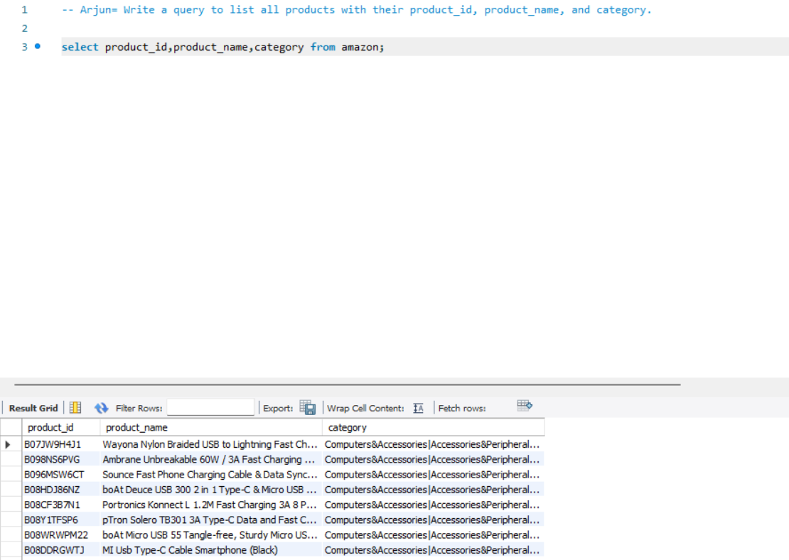
1)Write a query to list all products with their product_id, product_name, and category.

Slide 3
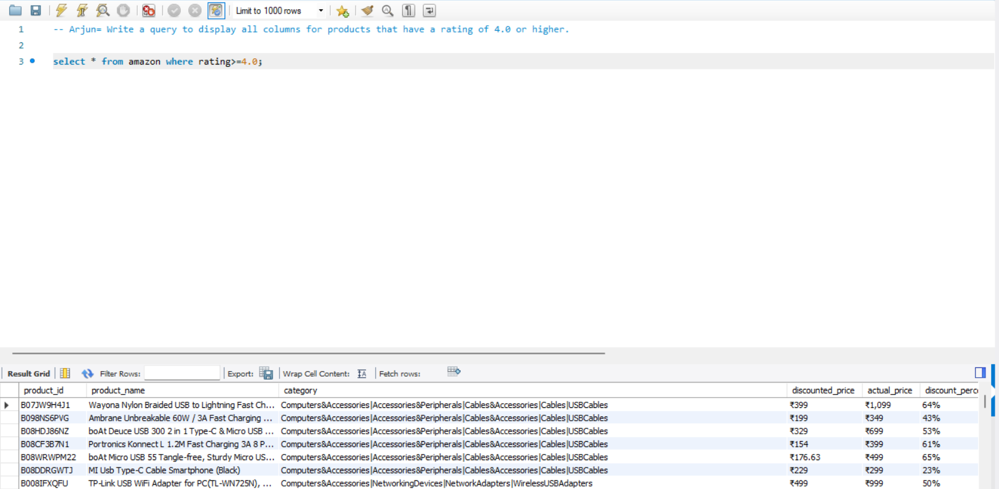
2) Write a query to display all columns for products that have a rating of 4.0 or higher.

Slide 4
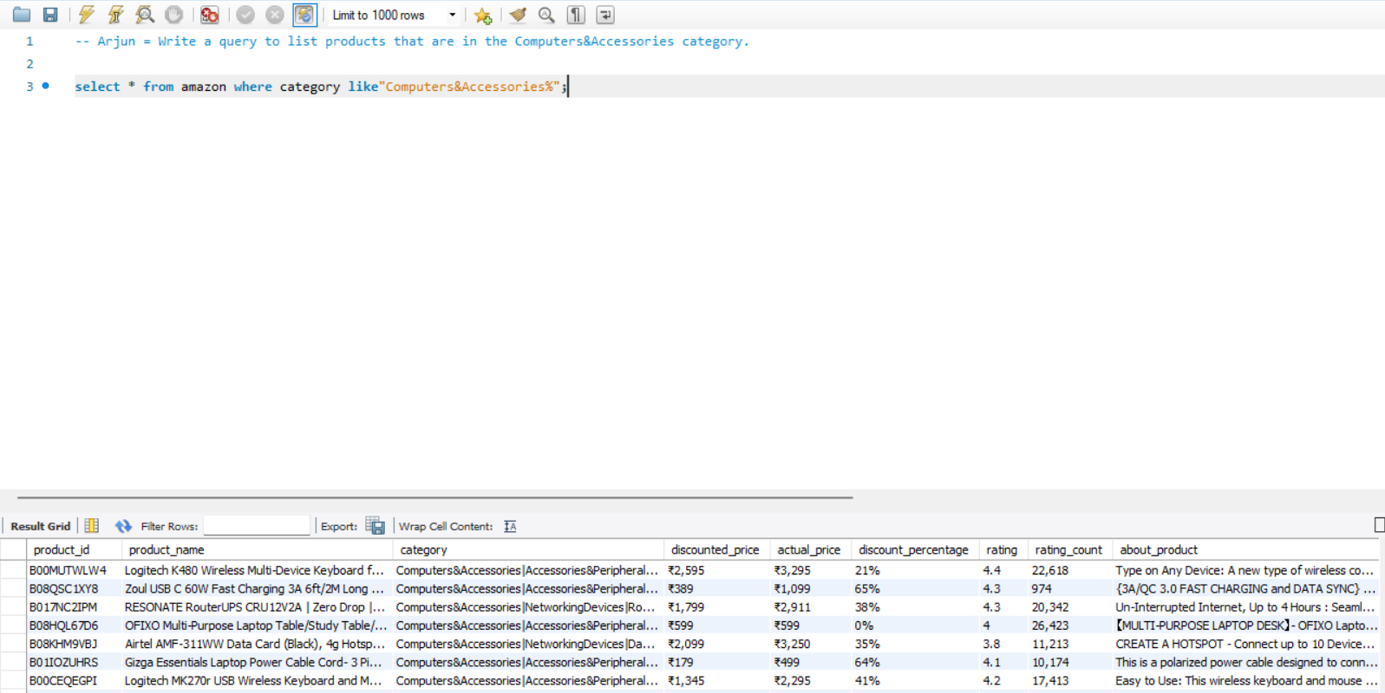
3)Write a query to list products that are in the Computers&Accessories category.

Slide 5
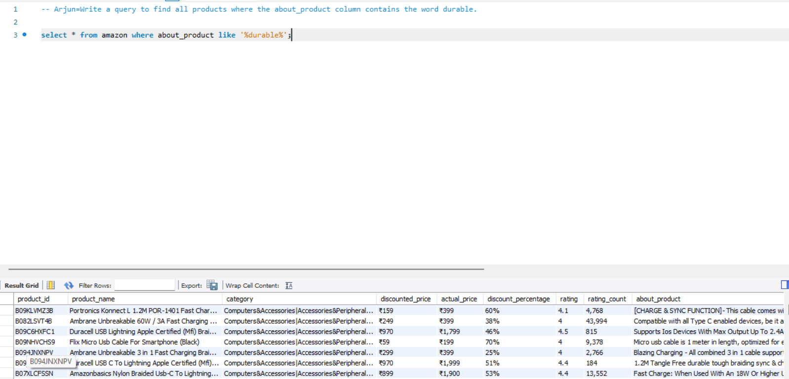
4) Write a query to find all products where the about_product column contains the word durable.

Slide 6
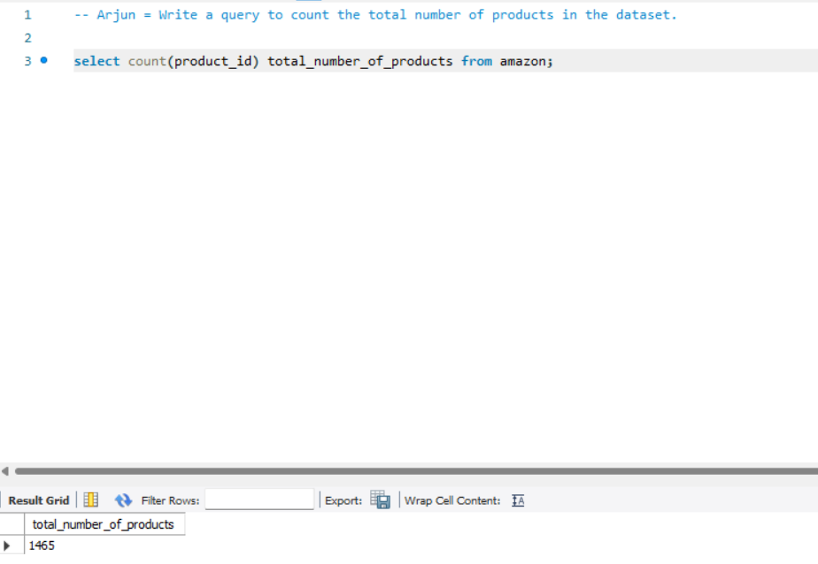
5) Write a query to count the total number of products in the dataset.

Slide 7
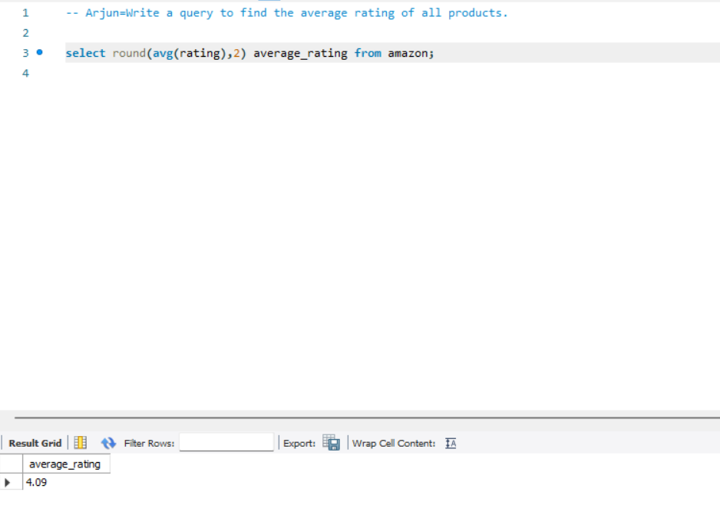
6) Write a query to find the average rating of all products.

Slide 8
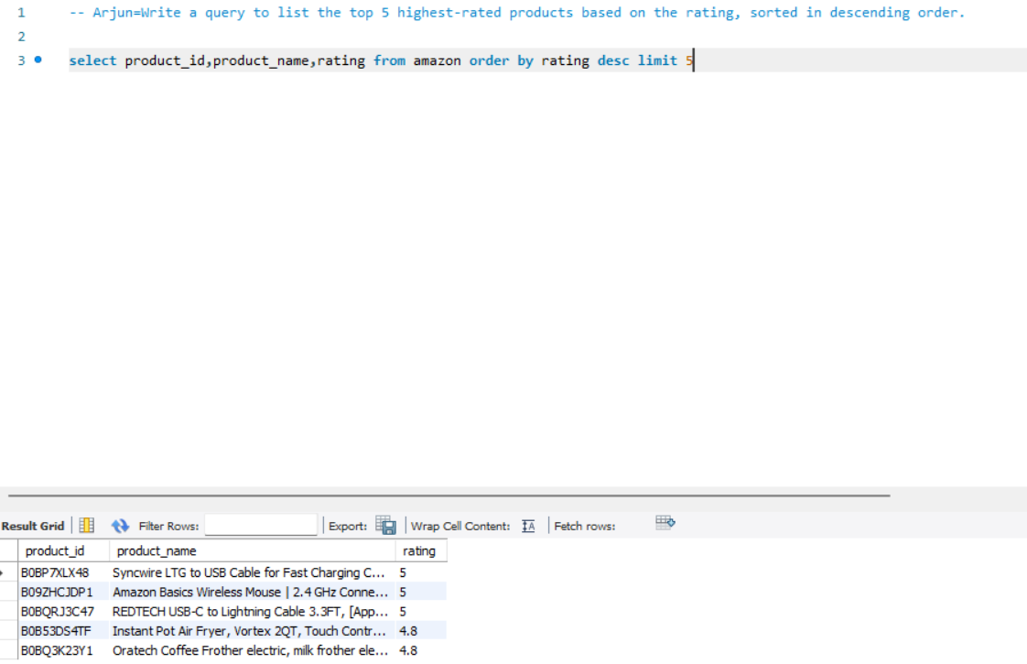
7) Write a query to list the top 5 highest-rated products based on the rating, sorted in descending order.

Slide 9
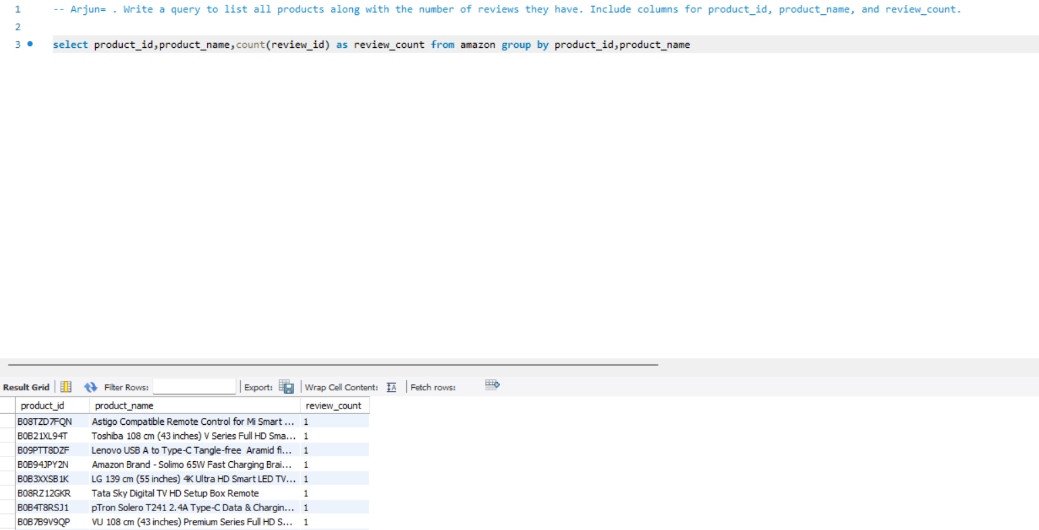
8) Write a query to list all products along with the number of reviews they have. Include columns for product_id, product_name, and review_count.

Slide 10
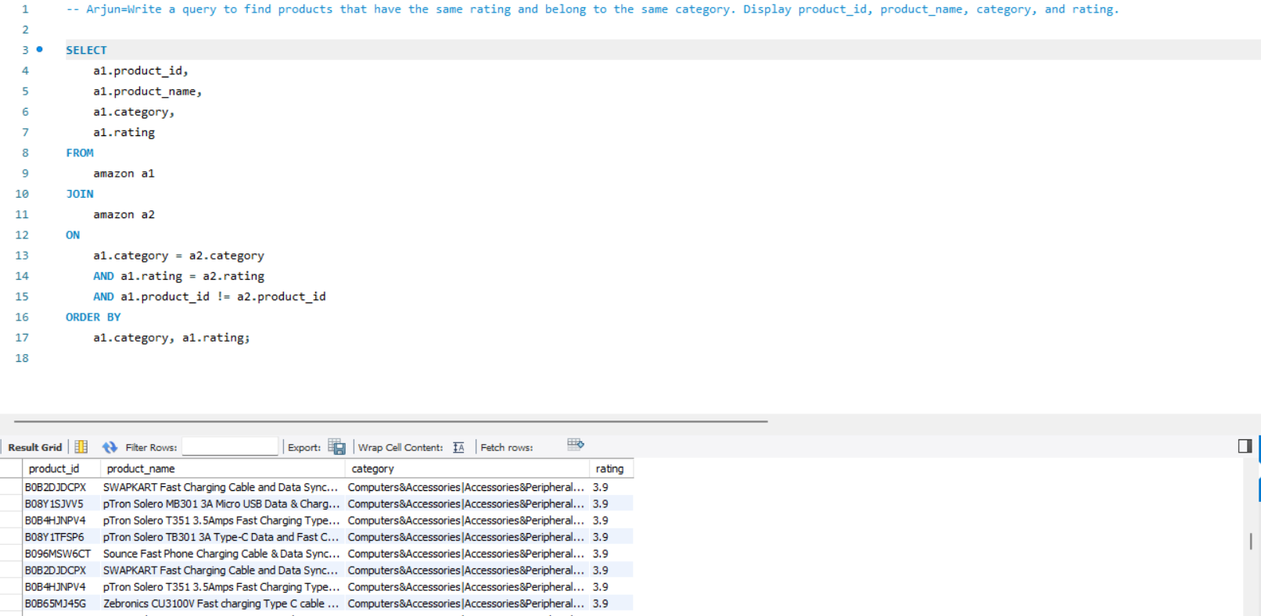
9) Write a query to find products that have the same rating and belong to the same category. Display product_id, product_name, category, and rating.

Slide 11
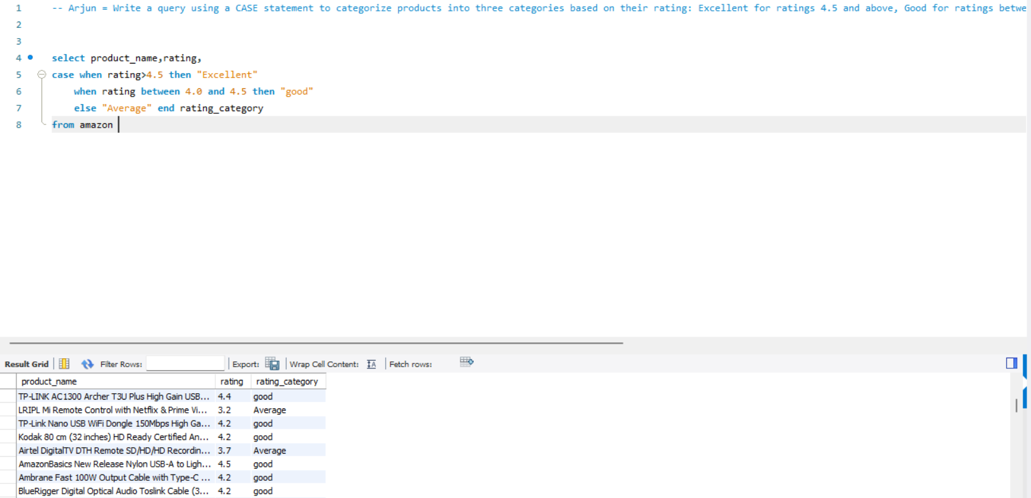
10) Write a query using a CASE statement to categorize products into three categories based on their rating: Excellent for ratings 4.5 and above, Good for ratings between 4.0 and 4.5, and Average for ratings below 4.0.

Slide 12
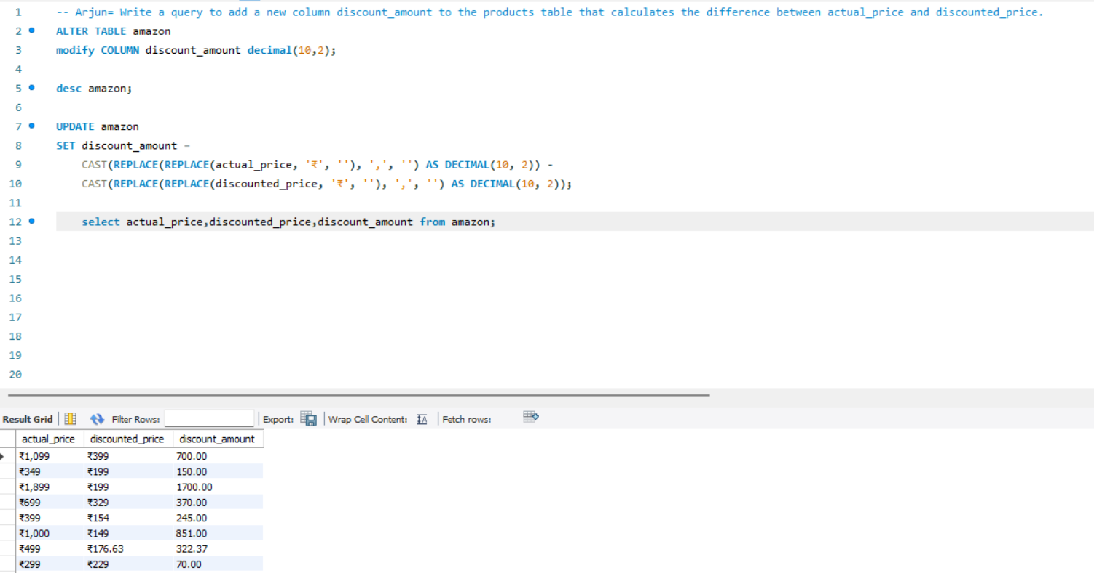
11) Write a query to add a new column discount_amount to the products table that calculates the difference between actual_price and discounted_price.

Slide 13
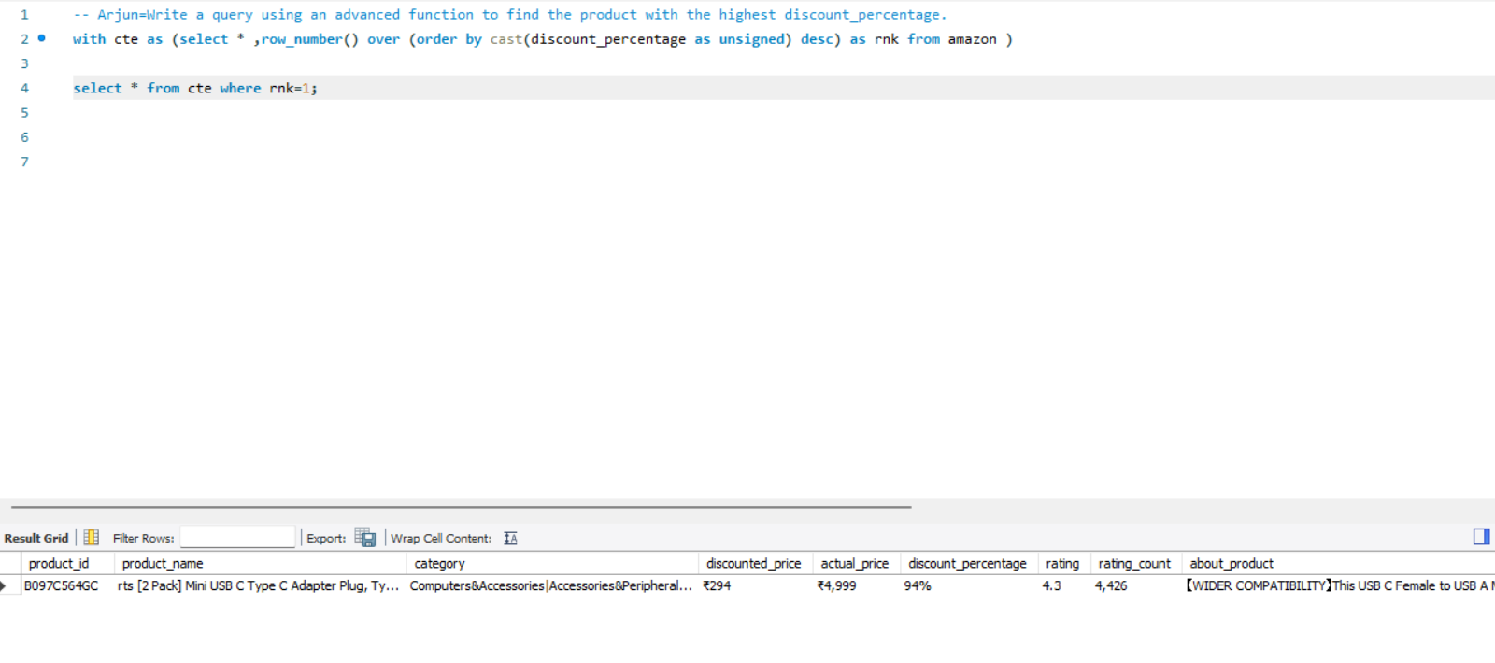
12) Write a query using an advanced function to find the product with the highest discount_percentage.

Slide 14
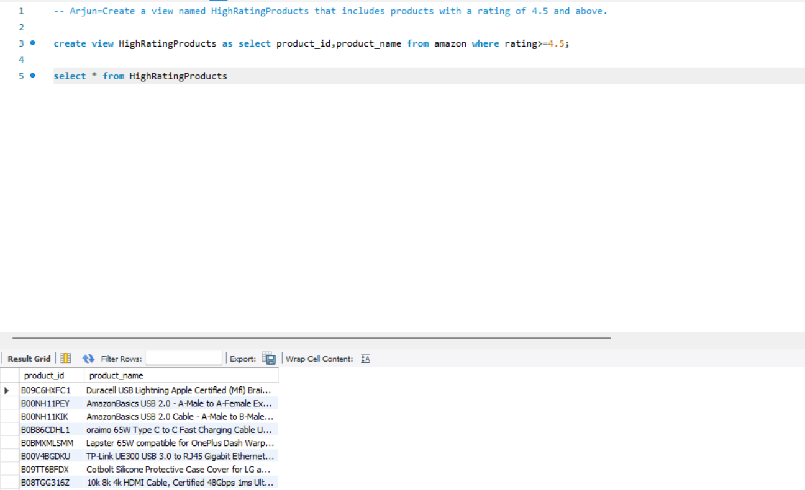
13) Create a view named HighRatingProducts that includes products with a rating of 4.5 and above.

Slide 15
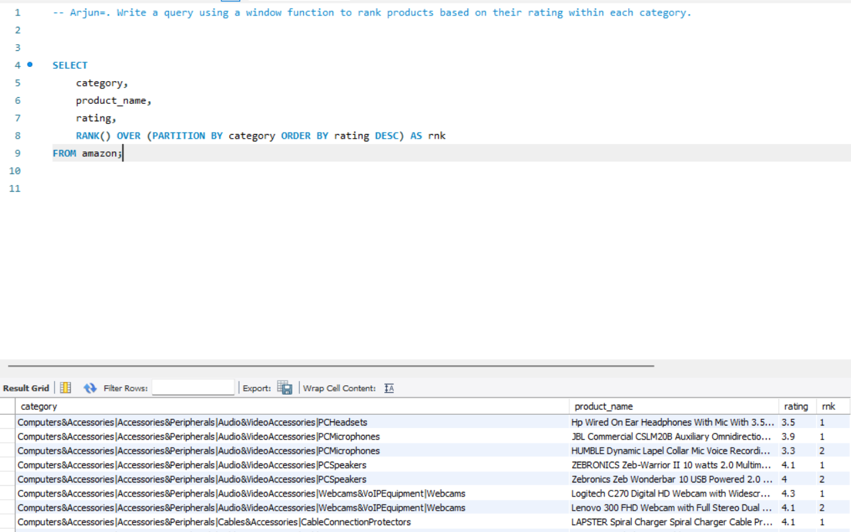
14) Write a query using a window function to rank products based on their rating within each category.

Slide 16
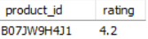
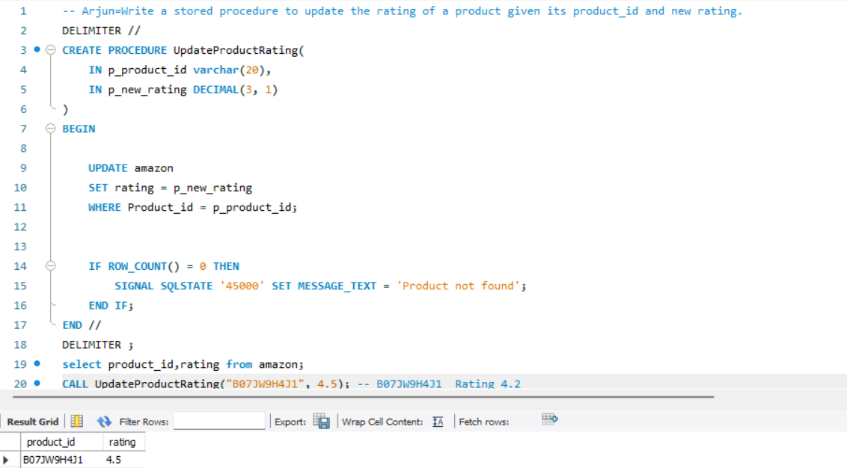
15) Write a stored procedure to update the rating of a product given its product_id and new rating.
BEFORE PROCEDURE CALL
AFTER PROCEDURE CALL

Slide 17
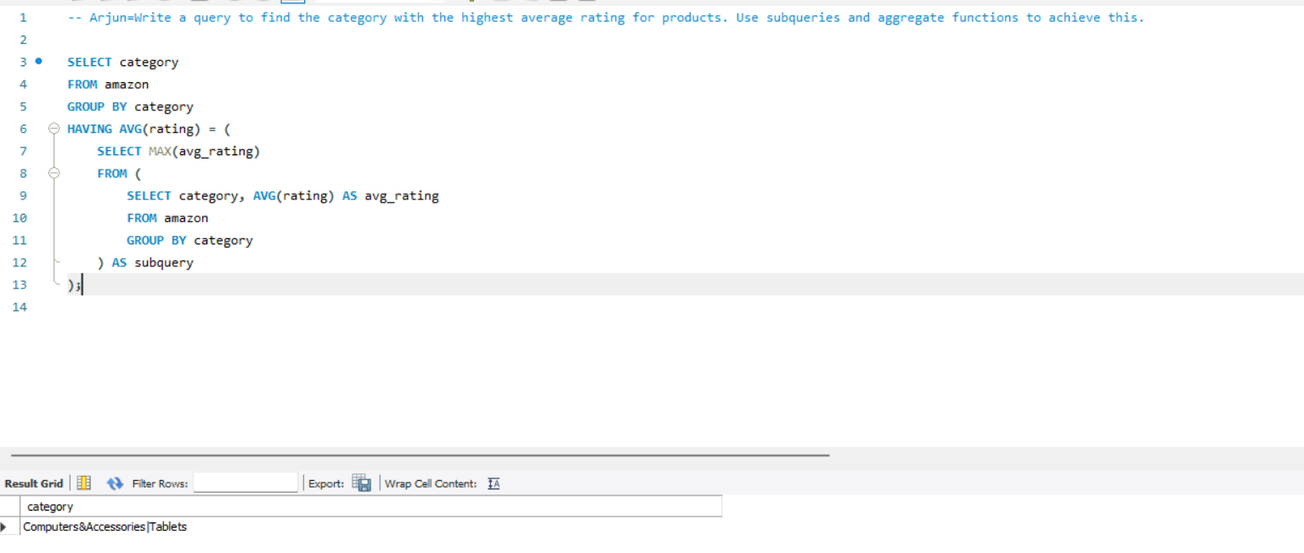
16) Write a query to find the category with the highest average rating for products. Use subqueries and aggregate functions to achieve this.

Slide 18
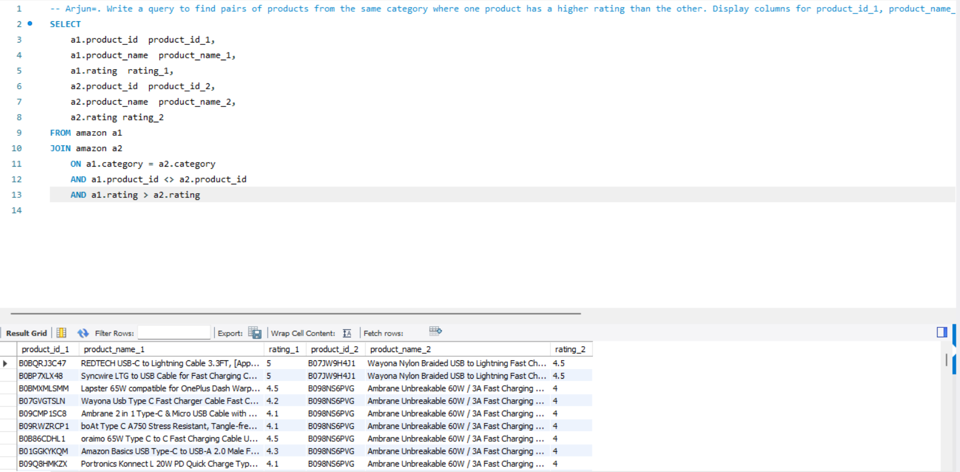
17) Write a query to find pairs of products from the same category where one product has a higher rating than the other. Display columns for product_id_1, product_name_1, rating_1, product_id_2, product_name_2, and rating_2.

Slide 19
Thank you

